Slide 1
Game Demo Video Presentation

Slide 2
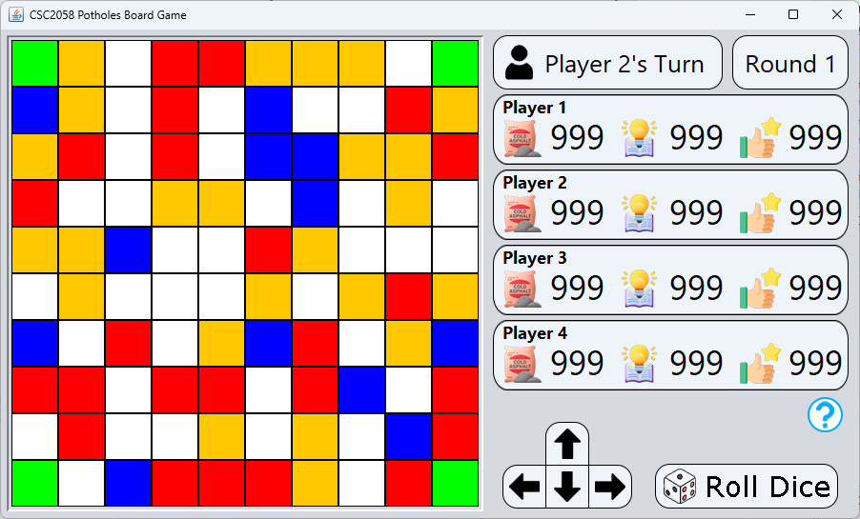

The GUI
Notes:
This is the main screen of the game.
[NEXT SLIDE] You can see the 10x10 game board on the left, where players will move across the squares representing potholes, knowledge, resource and spawn.
[NEXT SLIDE] On the right of the game board, there are player information displays showing the current resources, knowledge and satisfaction points for all players. This helps everyone keep track of their progress.
[NEXT SLIDE] Towards the top right, we have indicators for whose turn it is and the current round number. These make it easy to follow the game flow.
[NEXT SLIDE] At the bottom right, you’ll find buttons for rolling the dice and moving your player. These are the main controls for progressing in the game.
[NEXT SLIDE] Above the Roll Dice button, there’s a Help/Tutorial button. Players can click this to find useful information about the game, such as the meaning of symbols, how to move, and gameplay tips.

Slide 3
Game Board
The GUI
Key:
Pothole : Red
Knowledge : Blue
Resource : Orange
Spawn : Green
Normal : White
Notes:
This is the main screen of the game.
[NEXT SLIDE] You can see the 10x10 game board on the left, where players will move across the squares representing potholes, knowledge, resource and spawn.
[NEXT SLIDE] On the right of the game board, there are player information displays showing the current resources, knowledge and satisfaction points for all players. This helps everyone keep track of their progress.
[NEXT SLIDE] Towards the top right, we have indicators for whose turn it is and the current round number. These make it easy to follow the game flow.
[NEXT SLIDE] At the bottom right, you’ll find buttons for rolling the dice and moving your player. These are the main controls for progressing in the game.
[NEXT SLIDE] Above the Roll Dice button, there’s a Help/Tutorial button. Players can click this to find useful information about the game, such as the meaning of symbols, how to move, and gameplay tips.

Slide 4
Player Info Displays show the 3 player assets:
Resources (Cold Asphalt)
Knowledge Points
Satisfaction Points
Resources
The GUI
Key:
Pothole : Red
Knowledge : Blue
Resource : Orange
Spawn : Green
Normal : White
Notes:
This is the main screen of the game.
[NEXT SLIDE] You can see the 10x10 game board on the left, where players will move across the squares representing potholes, knowledge, resource and spawn.
[NEXT SLIDE] On the right of the game board, there are player information displays showing the current resources, knowledge and satisfaction points for all players. This helps everyone keep track of their progress.
[NEXT SLIDE] Towards the top right, we have indicators for whose turn it is and the current round number. These make it easy to follow the game flow.
[NEXT SLIDE] At the bottom right, you’ll find buttons for rolling the dice and moving your player. These are the main controls for progressing in the game.
[NEXT SLIDE] Above the Roll Dice button, there’s a Help/Tutorial button. Players can click this to find useful information about the game, such as the meaning of symbols, how to move, and gameplay tips.

Slide 5
Player Information
The GUI
Key:
Pothole : Red
Knowledge : Blue
Resource : Orange
Spawn : Green
Normal : White
Notes:
This is the main screen of the game.
[NEXT SLIDE] You can see the 10x10 game board on the left, where players will move across the squares representing potholes, knowledge, resource and spawn.
[NEXT SLIDE] On the right of the game board, there are player information displays showing the current resources, knowledge and satisfaction points for all players. This helps everyone keep track of their progress.
[NEXT SLIDE] Towards the top right, we have indicators for whose turn it is and the current round number. These make it easy to follow the game flow.
[NEXT SLIDE] At the bottom right, you’ll find buttons for rolling the dice and moving your player. These are the main controls for progressing in the game.
[NEXT SLIDE] Above the Roll Dice button, there’s a Help/Tutorial button. Players can click this to find useful information about the game, such as the meaning of symbols, how to move, and gameplay tips.

Slide 6
Movement & Roll Dice
The GUI
Key:
Pothole : Red
Knowledge : Blue
Resource : Orange
Spawn : Green
Normal : White
Notes:
This is the main screen of the game.
[NEXT SLIDE] You can see the 10x10 game board on the left, where players will move across the squares representing potholes, knowledge, resource and spawn.
[NEXT SLIDE] On the right of the game board, there are player information displays showing the current resources, knowledge and satisfaction points for all players. This helps everyone keep track of their progress.
[NEXT SLIDE] Towards the top right, we have indicators for whose turn it is and the current round number. These make it easy to follow the game flow.
[NEXT SLIDE] At the bottom right, you’ll find buttons for rolling the dice and moving your player. These are the main controls for progressing in the game.
[NEXT SLIDE] Above the Roll Dice button, there’s a Help/Tutorial button. Players can click this to find useful information about the game, such as the meaning of symbols, how to move, and gameplay tips.

Slide 7
Help / Tutorial
The GUI
Key:
Pothole : Red
Knowledge : Blue
Resource : Orange
Spawn : Green
Normal : White
Notes:
This is the main screen of the game.
[NEXT SLIDE] You can see the 10x10 game board on the left, where players will move across the squares representing potholes, knowledge, resource and spawn.
[NEXT SLIDE] On the right of the game board, there are player information displays showing the current resources, knowledge and satisfaction points for all players. This helps everyone keep track of their progress.
[NEXT SLIDE] Towards the top right, we have indicators for whose turn it is and the current round number. These make it easy to follow the game flow.
[NEXT SLIDE] At the bottom right, you’ll find buttons for rolling the dice and moving your player. These are the main controls for progressing in the game.
[NEXT SLIDE] Above the Roll Dice button, there’s a Help/Tutorial button. Players can click this to find useful information about the game, such as the meaning of symbols, how to move, and gameplay tips.

Slide 8
Simulated Movement
Key:
Pothole : Red
Knowledge : Blue
Resource : Orange
Spawn : Green
Normal : White
Notes:
Here’s how player movement works. Each player starts in the corner of the board and moves based on their dice roll. Players can choose their direction of movement, making strategy an important part of the game.
[NEXT SLIDE] For example, let’s say you roll a 3. This gives you three moves.
[NEXT SLIDE] You might decide to use all three moves to reach a pothole to the right, or you might choose to go to pothole below. Strategic decisions like this can impact your gameplay significantly.
[NEXT SLIDE] Once you’ve used all your moves, you can end your turn and let the next player roll the dice.

Slide 9
Simulated Movement
Key:
Pothole : Red
Knowledge : Blue
Resource : Orange
Spawn : Green
Normal : White
3 Moves
Notes:
Here’s how player movement works. Each player starts in the corner of the board and moves based on their dice roll. Players can choose their direction of movement, making strategy an important part of the game.
[NEXT SLIDE] For example, let’s say you roll a 3. This gives you three moves.
[NEXT SLIDE] You might decide to use all three moves to reach a pothole to the right, or you might choose to go to pothole below. Strategic decisions like this can impact your gameplay significantly.
[NEXT SLIDE] Once you’ve used all your moves, you can end your turn and let the next player roll the dice.

Slide 10
Simulated Movement
Key:
Pothole : Red
Knowledge : Blue
Resource : Orange
Spawn : Green
Normal : White
0 Moves
Notes:
Here’s how player movement works. Each player starts in the corner of the board and moves based on their dice roll. Players can choose their direction of movement, making strategy an important part of the game.
[NEXT SLIDE] For example, let’s say you roll a 3. This gives you three moves.
[NEXT SLIDE] You might decide to use all three moves to reach a pothole to the right, or you might choose to go to pothole below. Strategic decisions like this can impact your gameplay significantly.
[NEXT SLIDE] Once you’ve used all your moves, you can end your turn and let the next player roll the dice.

Slide 11
Simulated Movement
Key:
Pothole : Red
Knowledge : Blue
Resource : Orange
Spawn : Green
Normal : White
End Turn
Notes:
Here’s how player movement works. Each player starts in the corner of the board and moves based on their dice roll. Players can choose their direction of movement, making strategy an important part of the game.
[NEXT SLIDE] For example, let’s say you roll a 3. This gives you three moves.
[NEXT SLIDE] You might decide to use all three moves to reach a pothole to the right, or you might choose to go to pothole below. Strategic decisions like this can impact your gameplay significantly.
[NEXT SLIDE] Once you’ve used all your moves, you can end your turn and let the next player roll the dice.

Slide 12
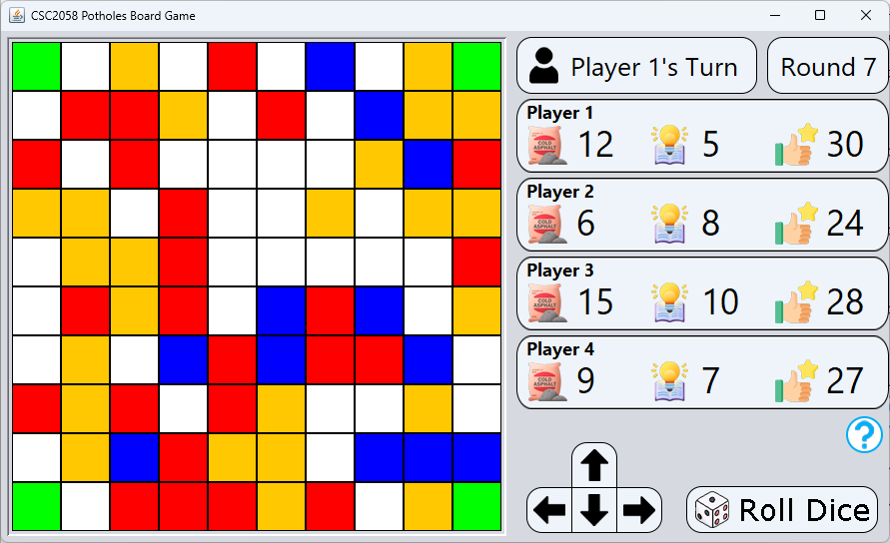
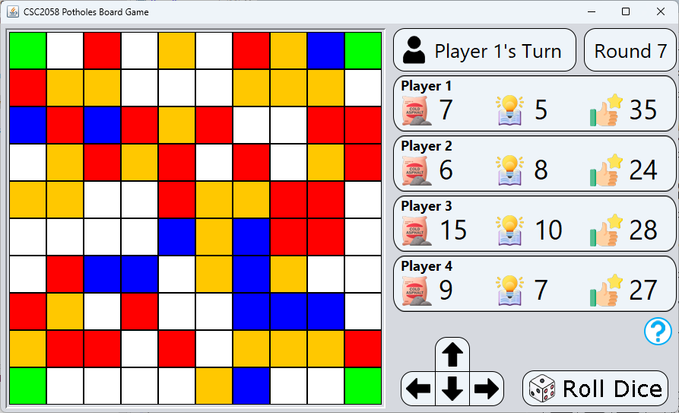
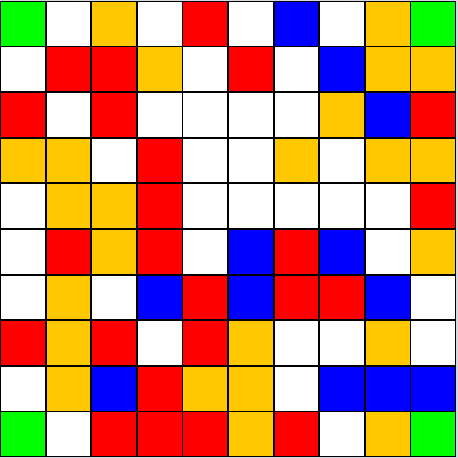
Simulated Fixing Pothole
Square 1D
Large Pothole
Rewards 5 Points.
Age: 3 Turns
Cost to Repair: 5 Asphalt
A damaged part of road which could cause issues for road users.
Would you like to repair?*
Before:
Player 1:
12 Asphalt, 5 Knowledge,
30 Points
After:
Player 1: 7 Asphalt,
5 Knowledge,
35 Points
Yes
No
*if the player does not have enough resources or knowledge, display "You do not have enough resources/knowledge to repair this pothole."
Notes:
When a player lands on a pothole tile, they have the option to repair it. Potholes come in three sizes: small, medium, and large. Small potholes require fewer resources to repair but award just 1 satisfaction point. Medium and large potholes need more resources but will award more satisfaction points. As time passes, unattended potholes grow in size, requiring more resources to repair. This adds urgency and strategy to the gameplay. When repairing a pothole, the game will deduct the required resources from your total. If you don’t have enough, you’ll need to gather more before you can proceed.

Slide 13
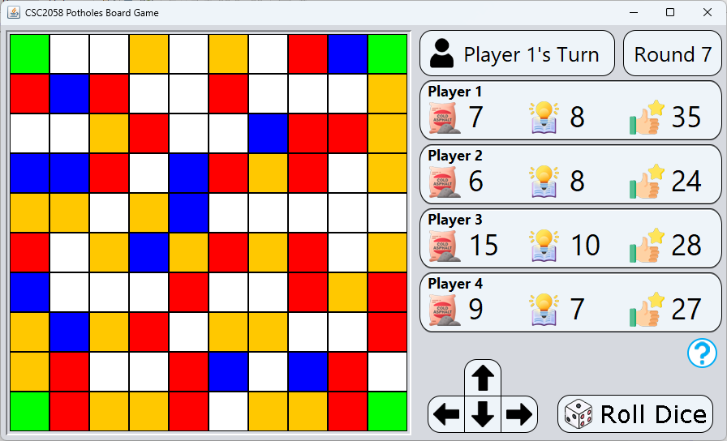
Simulated Knowledge
Square 0X Time: 30
Knowledge Square
Rewards 3 Knowledge.
Q: What is the name of the Pothole repair service in Johannesburg?
Pothole Patrol
Pothole Pirates
Road Repairs
Road Report
Before:
Player 1: 7 Asphalt, 5 Knowledge,
35 Points
After:
Player 1: 7 Asphalt, 8 Knowledge*,
35 Points
1
2
3
4
*if correct
Notes:
Landing on a knowledge square challenges the player with a multiple-choice question. These questions are designed to make the game educational by teaching players about pothole repair techniques, sustainability, or related topics. If the player answers correctly, they earn more knowledge points. However, even if they get it wrong, they still receive some points to encourage learning and participation. Knowledge points play a crucial role in the game. The more points a player has, the larger potholes they can repair, making knowledge an essential resource for progress and success. This mechanic encourages players to actively engage with the educational aspects of the game while balancing their strategy for gathering knowledge and other resources.

Slide 14
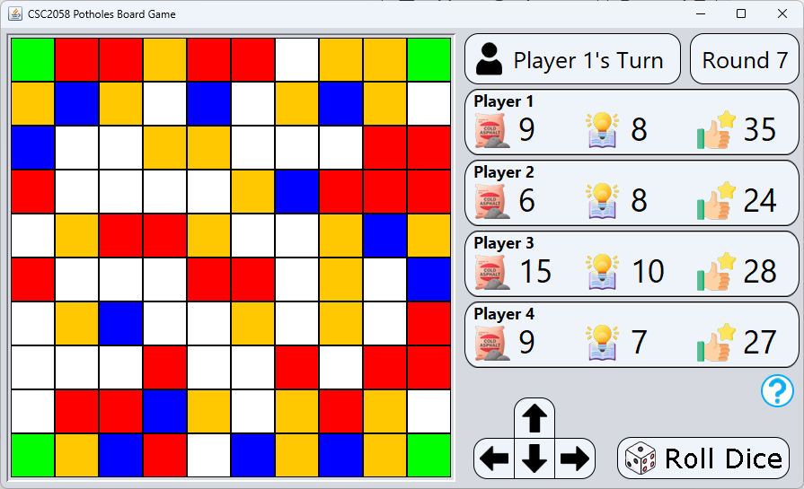
Simulated Resource
Square 0X
Resource Square
You have moderate knowledge, which rewards 2 resources.
Current Knowledge: 7
Next upgrade: 11
Before:
Player 1: 7 Asphalt, 8 Knowledge,
35 Points
After:
Player 1: 9 Asphalt,
8 Knowledge,
35 Points
Claim
Notes:
Resource tiles provide the materials needed to repair potholes. When a player lands on a resource square, they collect additional units of cold asphalt. The number of resources gained depends on the specific tile. Managing resources wisely is crucial, as running out means you won’t be able to repair potholes and earn satisfaction points. Strategic movement to land on resource tiles at the right time can keep you in the game and ahead of other players.

